Slide 1
Spring Boot Basics
1

Slide 2

Getting Started with Spring Boot
WHY Spring Boot?
You can build web apps & REST API WITHOUT Spring Boot
What is the need for Spring Boot?
WHAT are the goals of Spring Boot?
HOW does Spring Boot work?
COMPARE Spring Boot vs Spring MVC vs Spring

Slide 3
Getting Started with Spring Boot - Approach
1: Understand the world before Spring Boot (10000 Feet)
2: Create a Spring Boot Project
3: Build a simple REST API using Spring Boot
4: Understand the MAGIC of Spring Boot
Spring Initializr
Starter Projects
AutoConfiguration
Developer Tools
Actuator
...

Slide 4
World Before Spring Boot!
Setting up Spring Projects before Spring Boot was NOT easy!
We needed to configure a lot of things before we have a production-ready application.

Slide 5
World Before Spring Boot - 1 - Dependency Management
<dependency>
<groupId>org.springframework</groupId>
<artifactId>spring-webmvc</artifactId>
<version>6.2.2.RELEASE</version>
</dependency>
<dependency>
<groupId>com.fasterxml.jackson.core</groupId>
<artifactId>jackson-databind</artifactId>
<version>2.13.3</version>
</dependency>
<dependency>
<groupId>log4j</groupId>
<artifactId>log4j</artifactId>
<version>1.2.17</version>
</dependency>
Manage frameworks and versions
REST API - Spring framework, Spring MVC framework, JSON binding framework, ..
Unit Tests - Spring Test, Mockito, JUnit, ...

Slide 6
World Before Spring Boot - 2 - web.xml
<servlet>
<servlet-name>dispatcher</servlet-name>
<servlet-class> org.springframework.web.servlet.DispatcherServlet
</servlet-class>
<init-param>
<param-name>contextConfigLocation</param-name>
<param-value>/WEB-INF/todo-servlet.xml</param-value>
</init-param>
<load-on-startup>1</load-on-startup>
</servlet>
<servlet-mapping>
<servlet-name>dispatcher</servlet-name>
<url-pattern>/*</url-pattern>
</servlet-mapping>
Example: Configure DispatcherServlet for Spring MVC

Slide 7
World Before Spring Boot - 3 - Spring Configuration
<context:component-scan base-package="com.springweb" />
<bean
class="org.springframework.web.servlet.view.InternalResourceViewResolver">
<property name="prefix">
<value>/WEB-INF/views/</value>
</property>
<property name="suffix">
<value>.jsp</value>
</property>
</bean>
Define your Spring Configuration
Component Scan
View Resolver
....

Slide 8
World Before Spring Boot - 4 - NFRs
<plugin>
<groupId>org.apache.tomcat.maven</groupId>
<artifactId>tomcat7-maven-plugin</artifactId>
<version>2.2</version>
<configuration>
<path>/</path>
<contextReloadable>true</contextReloadable>
</configuration>
</plugin>
<dependency>
<groupId>log4j</groupId>
<artifactId>log4j</artifactId>
<version>1.2.17</version>
</dependency>
Handling NFR – Non Functional Requirements
Logging
Error Handling
Monitoring

Slide 9
World Before Spring Boot!
Setting up Spring Projects before Spring Boot was NOT easy!
1: Dependency Management (pom.xml)
2: Define Web App Configuration (web.xml) 3: Manage Spring Beans (context.xml)
4: Implement Non Functional Requirements (NFRs)
AND repeat this for every new project!
Typically takes a few days to setup for each project (and countless hours to maintain)

Slide 10
Understanding Power of Spring Boot
// http://localhost:8080/courses [
{
"id": 1,
"name": "Learn AWS", "author": "Namrata"
}
]
1: Create a Spring Boot Project
2: Build a simple REST API using Spring Boot

Slide 11
What's the Most Important Goal of Spring Boot?
Help you build PRODUCTION-READY apps QUICKLY
Build QUICKLY
Spring Initializr
Spring Boot Starter Projects
Spring Boot Auto Configuration
Spring Boot DevTools
Be PRODUCTION-READY
Logging
Different Configuration for Different Environments
Profiles, ConfigurationProperties
Monitoring (Spring Boot Actuator)
...

Slide 12
Spring Boot BUILD QUICKLY

Slide 13
Exploring Spring Boot Starter Projects
I need a lot of frameworks to build application features:
Build a REST API: I need Spring, Spring MVC, Tomcat, JSON conversion...
Write Unit Tests: I need Spring Test, JUnit, Mockito, ...
How can I group them and make it easy to build applications?
Starters: Convenient dependency descriptors for diff. features
Spring Boot provides variety of starter projects:
Web Application & REST API - Spring Boot Starter Web (spring-webmvc, spring- web, spring-boot-starter-tomcat, spring-boot-starter-json)
Unit Tests - Spring Boot Starter Test
Talk to database using JPA - Spring Boot Starter Data JPA
Talk to database using JDBC - Spring Boot Starter JDBC
Secure your web application or REST API - Spring Boot Starter Security
(REMEMBER) Starters: Define all application dependencies

Slide 14
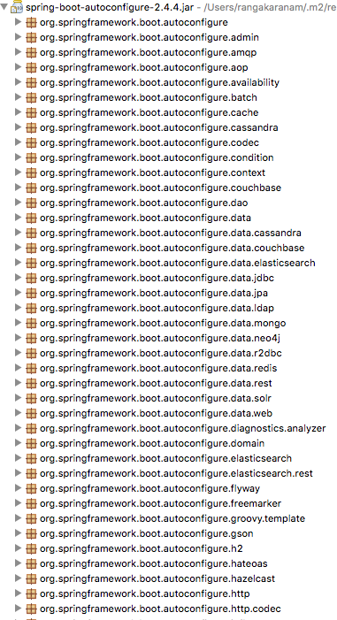
Exploring Spring Boot Auto Configuration
I need lot of configuration to build Spring app:
Component Scan, DispatcherServlet, Data Sources, JSON Conversion, ...
How can I simplify this?
Auto Configuration: Automated configuration for your app
Decided based on:
Which frameworks are in the Class Path?
What is the existing configuration (Annotations etc)? (can be used to override default auto-configuration)
Example: Spring Boot Starter Web
Dispatcher Servlet (DispatcherServletAutoConfiguration)
Embedded Servlet Container - Tomcat is the default (EmbeddedWebServerFactoryCustomizerAutoConfiguration)
Default Error Pages (ErrorMvcAutoConfiguration) Bean<->JSON
(JacksonHttpMessageConvertersConfiguration)
Notes:
Spring Boot auto-configuration automatically configures the Spring application based on the jar dependencies that we have added.
For example, if the H2 database Jar or mysql jar is present in the classpath and we have not configured any beans related to the database manually, the Spring Boot's auto-configuration feature automatically configures it in the project.
We can enable the auto-configuration feature by using the annotation @EnableAutoConfiguration. But this annotation does not use because it is wrapped inside the @SpringBootApplication annotation.
@SpringBootApplication=@ComponentScan+@EnableAutoConfiguration+@Configuration
The annotation @SpringBootApplication is the combination of three annotations: @ComponentScan, @EnableAutoConfiguration, and @Configuration.
We use @SpringBootApplication annotation instead of using @EnableAutoConfiguration.
When we add the spring-boot-starter-web dependency in the project, Spring Boot auto-configuration looks for the Spring MVC is on the classpath. It auto-configures dispatcherServlet, a default error page, and web jars.
Similarly, when we add the spring-boot-starter-data-jpa dependency, we see that Spring Boot Auto-configuration, auto-configures a datasource and an Entity Manager.
All auto-configuration logic is implemented in spring-boot-autoconfigure.jar

Slide 15
Understanding the Glue - @SpringBootApplication
Questions:
Who is launching the Spring Context?
Who is triggering the component scan?
Who is enabling auto configuration?
Answer: @SpringBootApplication
1: @SpringBootConfiguration: Indicates that a class provides Spring Boot application @Configuration.
2: @EnableAutoConfiguration: Enable auto-configuration of the Spring Application Context,
3: @ComponentScan: Enable component scan (for current package, by default)

Slide 16
Build Faster with Spring Boot DevTools
Increase developer productivity
Why do you need to restart the server manually for every code change?
Remember: For pom.xml dependency changes, you will need to restart server manually

Slide 17
Spring Boot
PRODUCTION-READY

Slide 18
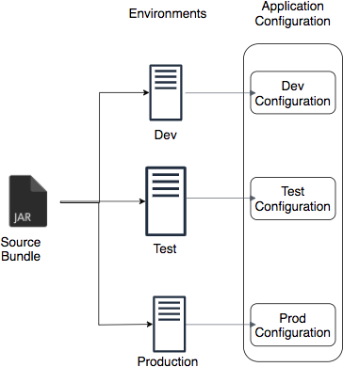
Managing App. Configuration using Profiles
Applications have different environments:
Dev, QA, Stage, Prod, ...
Different environments need different configuration:
Different Databases
Different Web Services
How can you provide different configuration for different environments?
Profiles: Environment specific configuration
How can you define externalized configuration for your application?
Configuration Properties: Define externalized configuration
Notes:
Step 1: create centralized ConfigurationService Component class to set configuration properties from properties file, annotate it with @ConfigrationProperties annotation
@ConfigurationProperties(prefix=“currency-service”)
@Component
public class CurrencyServiceConfiguration {
private String url;
private String username;
private String key;
//public setters and getters
}
Step 2: Autowire the configuration bean into controller wherever you need to use it’s properties.
@RestController
public class CurrencyController {
@Autowired
CurrencyServiceConfiguration configuration;
@RequestMapping(“/currency-service”)
public CurrencyServiceConfiguration getCurrencyDetails()
{
return configuration;
}
}
Step 3: configure diff Configuration properties for currency-service into application-properties based on diff. profiles
application.properties
server.port=8081
currency-service.url=“http://default.currencyservice.com
currency-service.username=“default user”
currency-service.key=“defaultkey”
spring.profiles.active=“dev”
application-dev.properties
server.port=8083
currency-service.url=“http://dev.currencyservice.com
currency-service.username=“dev user”
currency-service.key=“devkey”

Slide 19
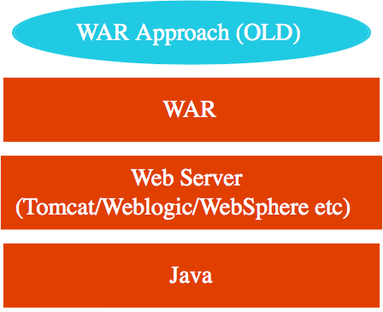
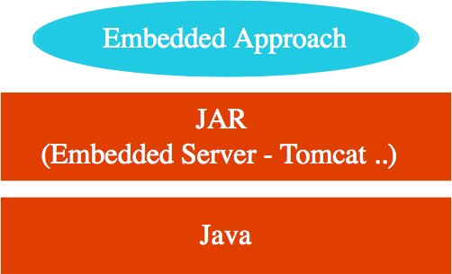
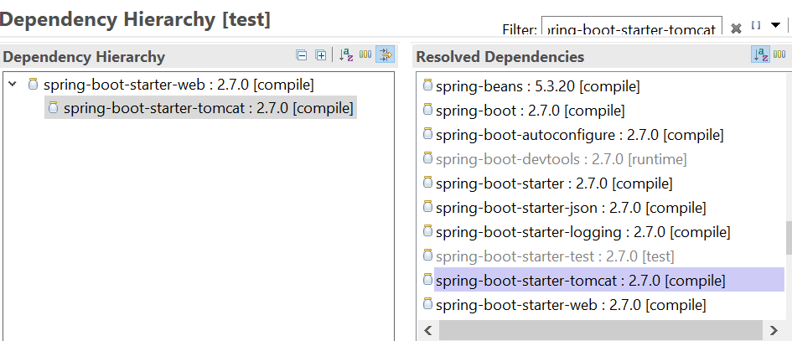
Simplify Deployment with Spring Boot Embedded Servers
How do you deploy your application?
Step 1 : Install Java
Step 2 : Install Web/Application Server
Tomcat/WebSphere/WebLogic etc
Step 3 : Deploy the application WAR (Web ARchive)
This is the OLD WAR Approach
Complex to setup!
Embedded Server - Simpler alternative
Step 1 : Install Java
Step 2 : Run JAR file
Make JAR not WAR (Credit: Josh Long!) Embedded Server Examples:
spring-boot-starter-tomcat
spring-boot-starter-jetty spring-boot-starter-undertow
Notes:
Right click application→ run as → maven build… → in the goals → clean install → run the app (check the application base directory, it should be correct)
In the target folder, jar file will be created. (can cd to that folder from command prompt)
Open command prompt, goto target folder , dir and check for jar file
java —version (for spring boot 3, java version should be 17 or above)
java –jar jarfilename.jar
You can see that application gets launched. (embedded tomcat server is started and application is deployed and started.)
you can test it from browser.
(don’t forget to close earlier application before launching this one, otherwise tomcat server port will clash)
7) Press cntrl-c to stop the application on command prompt.
Spring-boot-starter-web dependency in pom.xml has spring-boot-starter-tomcat dependency
Which brings in (embedded) tomcat server as part of jar

Slide 20
Monitor Applications using Spring Boot Actuator
Monitor and manage your application in your production Provides a number of endpoints:
beans - Complete list of Spring beans in your app
health - Application health information
metrics - Application metrics
mappings - Details around Request Mappings
Notes:
(Note: install plugin jsonprettyformatter in chrome browser to see well-formatted json output in broswer)
Step 1: add spring boot actuator dependency (you can also add it at start from starter.spring.io)
Step 2: save and restart an application. Go to browser and type: http://localhost:8081/actuator
by default it exposes only link to health endpoint (as part of json output), click on link to check the health of ur application.
Step 3: for enabling other endpoints, add below configuration to properties files :-
management.endpoints.web.exposure.include=*
Step 4: refresh the page in browser to resend the request. Now you can see all the diff endpoints links exposed by actuator
Step 5: click on beans link, it will show all beans that are configured as part of ur application.
you have created CourseController bean earlier, search for it in search box and locate that bean in the json-list of configured beans.
you will also find DispatcherServlet bean, ErrorMvcAutoConfiguration bean
for all auto-configured beans, you will find entry here.(can check if a bean is autoconfigured or not here)
Step 6: click on configprops link. It will show all the configuration properties configured in application.properties of our application. (try and locate
currency-service configuration that you created in earlier example. Also check the name of which properties file/profilr that property is configured)
Step 7: click on env endpoint. It shows all environment details. Like server port on which app is running, java version, java classpath and many more env details.
Step 8: click on metrics endpoint link. It will show list of various metrics that you can see for ur application.
pick up metric http.server.requests metric and append it at the end of current url so that the url now becomes
http://localhost:8081/actuator/http.server.requests and hit it.you can see various metric parameter values related to http request like
count (of total requests), total-time taken for execution of these many requests., maximum time taken for particular request.
if you refresh original actuator url request and hit it few times and then check http.server.requests count again, it will show that count has increased.
Note: whenever u enable actuator u r gathering lot information so it uses more cpu and more memory.so typically you explicitly configure only those endoints which u need as follows.
management.endpoints.web.exposure.include=health,metrics

Slide 21
Understanding Spring Boot vs Spring MVC vs Spring
Spring Boot vs Spring MVC vs Spring: What's in it?
Spring Framework: Dependency Injection
@Component, @Autowired, Component Scan etc..
Just Dependency Injection is NOT sufficient (You need other frameworks to build apps)
Spring Modules and Spring Projects: Extend Spring Eco System
Provide good integration with other frameworks (Hibernate/JPA, JUnit & Mockito for Unit Testing)
Spring MVC (Spring Module): Simplify building web apps and REST API
Building web applications with Struts was very complex
@Controller, @RestController, @RequestMapping("/courses")
Spring Boot (Spring Project): Build PRODUCTION-READY apps QUICKLY
Starter Projects - Make it easy to build variety of applications
Auto configuration - Eliminate configuration to setup Spring, Spring MVC and other frameworks!
Enable non functional requirements (NFRs):
Actuator: Enables Advanced Monitoring of applications
Embedded Server: No need for separate application servers!
Logging and Error Handling
Profiles and ConfigurationProperties

Slide 22

Spring Boot - Review
Goal: 10,000 Feet overview of Spring Boot
Help you understand the terminology!
Starter Projects
Auto Configuration Actuator
DevTools
Advantages: Get started quickly with production ready features!

